Slide 1


Slide 2


Decision Making
Topic/Course
Sub-Topic (Example: name of college)

Slide 3
Decision/Selection statements
if
if else
nested if
if else if
switch case

Slide 4
Simple if
It is used to decide whether certain statement or block of statements will be executed or not.

Slide 5
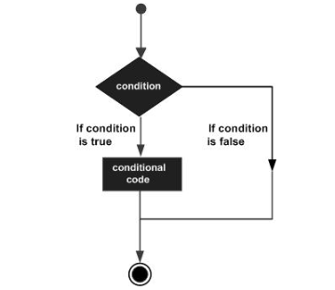
Syntax:
if (condition)
{ // Executes this block if condition is true
}

Slide 6

public class IfExample {
public static void main(String[] args) {
int age=20;
if(age>18){
System.out.print("Age is greater than 18");
}
}
}
output
1
2
3
4
5
6
7
8
Age is greater than 18

Slide 7
if else
It is used for two way decision making.
If the condition is true then the if part is executed and if the condition is false the else part will be executed.

Slide 8
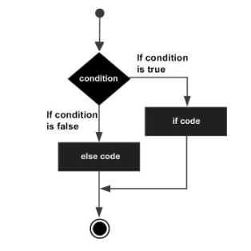
Syntax:
if (condition)
{
// Executes this block if condition is true
}
else
{
// Executes this block if condition is false
}

Slide 9
class IfElseDemo
{
public static void main(String args[])
{
int i = 10;
if (i < 15)
System.out.println("i is smaller than 15");
else
System.out.println("i is greater than 15");
}
}
output
1
2
3
4
5
6
7
8
9
10
11
i is smaller than 15

Slide 10
Nested if
An if else statement can contain any sort of statement within it.
It can contain another if-else statement
An if-else may be nested within the if part.
An if-else may be nested within the else part.
An if-else may be nested within both parts.

Slide 11
Syntax:
if (condition1)
{
// Executes when condition1 is true
if (condition2)
{
// Executes when condition2 is true
}
}

Slide 12
class NestedIfDemo
{
public static void main(String args[])
{
int i = 10;
if (i == 10)
{
if (i < 15)
System.out.println("i is smaller than 15");
if (i < 12)
System.out.println("i is smaller than 12 too");
else
System.out.println("i is greater than 15");
}
}
}
output
1
2
3
4
5
6
7
8
9
10
11
12
13
14
15
16
i is smaller than 15
i is smaller than 12 too

Slide 13
if else if
If else if statement is a multiway branch statement.
In if-else-if statement, as soon as the condition is met, the corresponding set of statements get executed, rest gets ignored.

Slide 14
Syntax:
if (condition1)
statement1;
else if (condition2)
statement2;
.
.
else
statement n;

Slide 15
class ifelseifDemo
{
public static void main(String args[])
{
int i = 20;
if (i == 10)
System.out.println("i is 10");
else if (i == 15)
System.out.println("i is 15");
else if (i == 20)
System.out.println("i is 20");
else
System.out.println("i is not present");
}
}
output
1
2
3
4
5
6
7
8
9
10
11
12
13
14
15
16
i is 20

Slide 16
switch case
The switch statement is a multiway branch statement.
Expression can be of type byte, short, int char or an enumeration, String.
The break statement is optional. If omitted, execution will continue on into the next case.

Slide 17
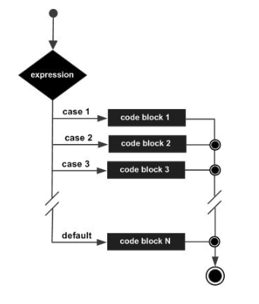
Syntax:
switch (expression)
{
case value1: statement1;
break;
case value2: statement2;
break;
.
.
case valueN: statementN;
break;
default: statementDefault;
}

Slide 18
class SwitchCaseDemo
{
public static void main(String args[])
{
int i = 9;
switch (i)
{
case 0:
System.out.println("i is zero.");
break;
case 1:
System.out.println("i is one.");
break;
case 2:
System.out.println("i is two.");
break;
default:
System.out.println("i is greater than 2.");
}
}
}
output
1
2
3
4
5
6
7
8
9
10
11
12
13
14
15
16
17
18
19
20
21
i is greater than 2.

Slide 19

// Predict the output
class Test {
public static void main(String[] args)
{
int x = 10;
if (x) {
System.out.println("HELLO");
} else {
System.out.println("BYE");
}
}
}
1
2
3
4
5
6
7
8
9
10
11
12
13
14
15
16
17
18
19
20
21
22

Slide 20
OUTPUT
1. HELLO 2. Compile time error 3. Runtime Error 4. BYE
Notes:
Output: Compile time error
The argument of if statement should be Boolean type. By mistake if we are trying to provide any other data type then we will get compile-time error saying incompatible types. Here the argument is of int type, therefore we will get compile time error saying error: incompatible types: int cannot be converted to Boolean

Slide 21
// Predict the output
class Test {
public static void main(String[] args)
{
int x = 10;
if (x)
System.out.println("HELLO");
System.out.println("WELCOME");
else
{
System.out.println("BYE");
}
}
}
1
2
3
4
5
6
7
8
9
10
11
12
13
14
15

Slide 22
OUTPUT
1. HELLO WELCOME 2. HELLO 3. BYE 4. Compile time error
Notes:
Output: Compile time error
Curly braces are optional in if part. Without curly braces only one statement is allowed under if. If we will try to give more than one statement then we will get compile time error saying error: ‘else’ without ‘if’.

Slide 23
// Predict the output
class Test {
public static void main(String[] args)
{
if (true)
;
}
}
1
2
3
4
5
6
7
8

Slide 24
OUTPUT
1. No Output 2. Compile time error 3. Runtime error 4. Runtime Exception
Notes:
Output: No Output
;(semicolon) is a valid java statement which is also known as empty statement. Therefore we can apply it in if statement also.

Slide 25
// Predict the output
class MainClass {
public static void main(String[] args)
{
int x = 10;
switch (x + 1 + 1) {
case 10:
System.out.println("HELLO");
break;
case 10 + 1 + 1:
System.out.println(“BYE");
break;
}
}
}
1
2
3
4
5
6
7
8
9
10
11
12
13
14
15

Slide 26
OUTPUT
1. Compile time error 2. BYE 3. HELLO 4. No Output
Notes:
Output: BYE
Both Switch argument and case label can be expressions. But case label should be constant expression.Here the case label “10+1+1” is treated as case 12 and switch argument “x+1+1” is also treated as 12.

Slide 27
// Predict the output
public class A {
public static void main(String[] args)
{
if (true)
break;
}
}
1
2
3
4
5
6
7
8

Slide 28
OUTPUT
1. Nothing 2. Error
Notes:
Output: Error
Break statement can only be used with loop or switch. So, using break with if statement causes “break outside switch or loop” error.

Slide 29

THANK YOU
Notes:
Thank you slide

